Slide 1


CS-446: Information Systems Security
Lecture # 4: Block Ciphers
Prof. Dr. Sufian Hameed
Department of Computer Science
FAST-NUCES

Slide 2
Block Cipher

Slide 3
Modern Ciphers
Modern ciphers
Sophisticated design using substitutions and permutations
Round-based encryption and decryption algorithms
Efficient implementations in hardware and software
Common classes of modern ciphers
Block ciphers = processing of fixed-length blocks
Examples: DES, AES, Blowfish
Stream ciphers = processing of individual bits or bytes
Examples: RC4, A5/1

Slide 4
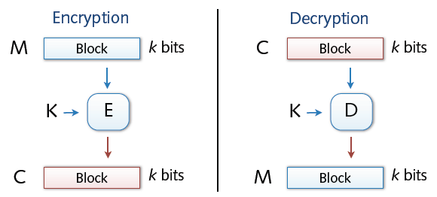
Block Cipher
Encryption and decryption in blocks (e.g., 64 or 128 bit)
Padding of short messages, splitting of long messages
Different modes of operations: ECB, CBC, CTR, ...
Examples:
DES: n= 64 bits, k = 56 bits
3DES: n= 64 bits, k = 168 bits
AES: n=128 bits, k = 128, 192, 256 bits

Slide 5
Block Ciphers Built by Iteration
key k
key expansion
k₁
k₂
k₃
k_{n}
m
R(k₁, ⋅)
R(k₂, ⋅)
R(k₃, ⋅)
R(k_{n}, ⋅)
c
R(k,m) is called a round function
for DES (n=16), 3DES (n=48) and AES-128 (n=10)
Notes:
Typically built on iterations

Slide 6
Now block ciphers are typically built by iteration.
They take in as input a key K, for example in the case of AES the key could be 128 bits long
And the first thing that happens to the key is that it gets expanded into a sequence of keys K1 to Kn called round keys.
Now, the way the cipher uses these round keys by iteratively encrypting the message again and again and again using what's called a round function.
So here we have this function R that take two inputs.
This function R is will be called a round function.
It takes as input the round key, and it takes as input the current state of the message.
So here we have our input message. for AES, the message would be 128 bits exactly, because each block in AES is exactly 128 bits. And then the first thing that happens is we apply the first round function using the key K1 to the message. And we get some new message out, as a result. Then we take this message m1, we apply the next round function to it using a different key, using the key k2.

Slide 7
Then we get the next round message out.
And so on and so forth until all the rounds have been applied and then the final output is actually the result of the cipher.
And again this would be also in the case of AES, this was 128 bits. And the resulting cipher text would also be 128 bits.
Now, different ciphers have different number of rounds, and they have different round functions.
So, for example, for triple DES the number of rounds is 48.
For AES, the number of rounds is only ten.

Slide 8
Design Characteristics for Block Ciphers
Choice of blocklength n
n too long → complex algorithm, performance loss
n too short → weak encryption, easy to attack
Modern variants use n = 128 - 256 bit
Choice of the key length of k
Practical key length: 80 - 256 bit
k too short → systematic testing of all valid keys (Brute Force attack)
Against Brute Force attacks, a minimum of 70-80 bit are necessary

Slide 9
Confusion and Diffusion (Recap)
What makes a cipher secure? Hard to tell
Confusion property
Complex relation between key and plaintext/ciphertext
✸ Hard to deduce key from plaintext/ciphertext pairs
Diffusion property
Complex relation between plaintext and ciphertext
✸ Hard to deduce bits of plaintext from ciphertext

Slide 10
Product Ciphers
Shannon introduced the concept of a product cipher. A product cipher is a complex cipher combining substitution, permutation, and other components discussed in previous sections.

Slide 11

Continued
Diffusion
The idea of diffusion is to hide the relationship between the ciphertext and the plaintext.
Note
Diffusion hides the relationship between the ciphertext and the plaintext.

Slide 12
Continued
Confusion
The idea of confusion is to hide the relationship between the ciphertext and the key.
Note
Confusion hides the relationship between the ciphertext and the key.

Slide 13
Continued
Rounds
Diffusion and confusion can be achieved using iterated product ciphers where each iteration is a combination of S-boxes, P-boxes, and other components.

Slide 14
Data Encryption Standard (DES)

Slide 15
Chapter 4
Objectives
❏ To review a short history of DES
❏ To define the basic structure of DES
❏ To describe the details of building elements of DES
❏ To describe the round keys generation process
❏ To analyze DES

Slide 16
INTRODUCTION
The Data Encryption Standard (DES) is a symmetric-key block cipher published by the National Institute of Standards and Technology (NIST).
Topics discussed in this section:
1) History 2) Overview

Slide 17
1 History
In 1973, NIST published a request for proposals for a national symmetric-key cryptosystem. A proposal from IBM, a modification of a project called Lucifer, was accepted as DES. DES was published in the Federal Register in March 1975 as a draft of the Federal Information Processing Standard (FIPS).

Slide 18
The Data Encryption Standard (DES)
Early 1970s: Horst Feistel designs Lucifer at IBM
key-len = 128 bits ; block-len = 128 bits
1973: National Bureau of Standards (NBS) asks for block cipher proposals
IBM submits variant of Lucifer.
1976: NBS adopts DES as a federal standard
key-len = 56 bits ; block-len = 64 bits
Every 5 years:
DES review for decision about further usage
Result: Until now, no modifications were made

Slide 19
The Data Encryption Standard (DES)
Problem of DES:
Usage of a key with a length of 56 bit
Criticized for a key length too short for usage in practice
1997: DES broken by exhaustive search
2000: NIST adopts Rijndael as AES to replace DES

Slide 20
DES Challenge
1997: Internet search -- 3 months
1998: by distributed.net in 41 days in early 1998.
The plaintext was "The secret message is: Many hands make light work.“
1998: Electronic Frontier Foundation (EFF) machine (deep crack) -- 56 hours
The text was revealed to be "The secret message is: It's time for those 128-, 192-, and 256-bit keys.“
1999: combined search -- 22 hours
The plaintext was See you in Rome (second AES Conference, March 22-23, 1999)
⇒ 56-bit ciphers should not be used !! (128-bit key ⇒ 2⁷² days)

Slide 21
General Structure of DES
DES uses blocks of length n = 64 bit
Length of key k is 56 bit
Encryption takes place in 16 identical rounds with round keys k_{i} of 48 bit length
Encryption process
1. step: permutation performed on the input block
2. step: generation of round keys
3. step: performing 16 identical rounds
4. step: inverse permutation to step 1

Slide 22
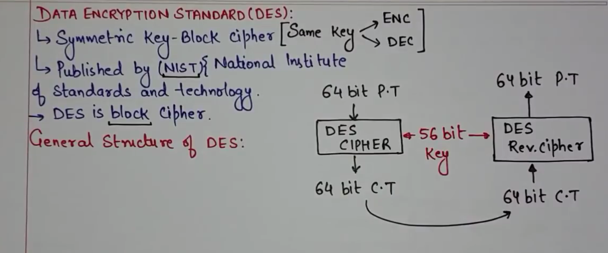

Slide 23
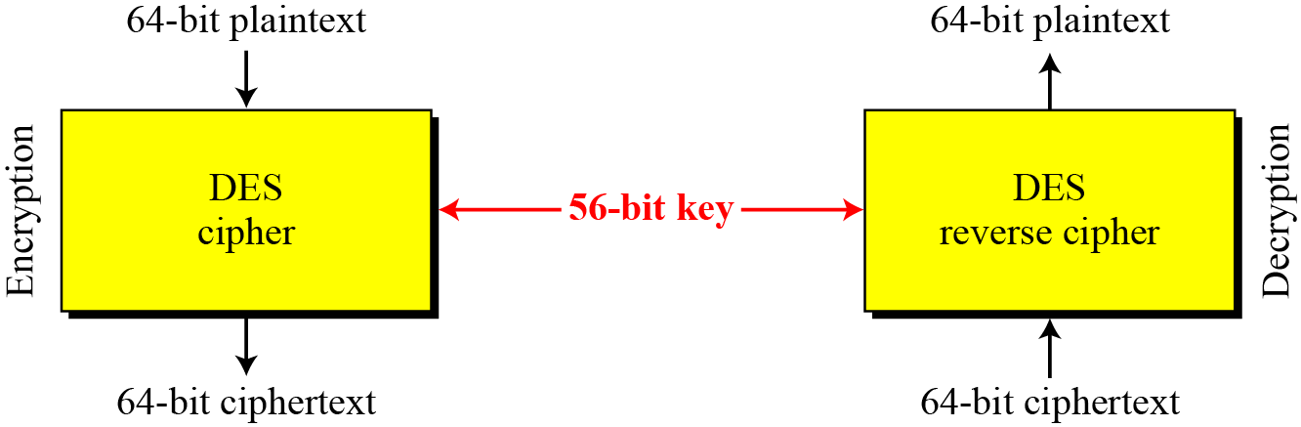
2 Overview
DES is a block cipher, as shown in Figure 6.1.
Figure 6.1 Encryption and decryption with DES

Slide 24
4-2 DES STRUCTURE
The encryption process is made of two permutations (P-boxes), which we call initial and final permutations, and sixteen Feistel rounds.
Topics discussed in this section:
6.2.1 Initial and Final Permutations 6.2.2 Rounds
6.2.3 Cipher and Reverse Cipher
6.2.4 Examples

Slide 25
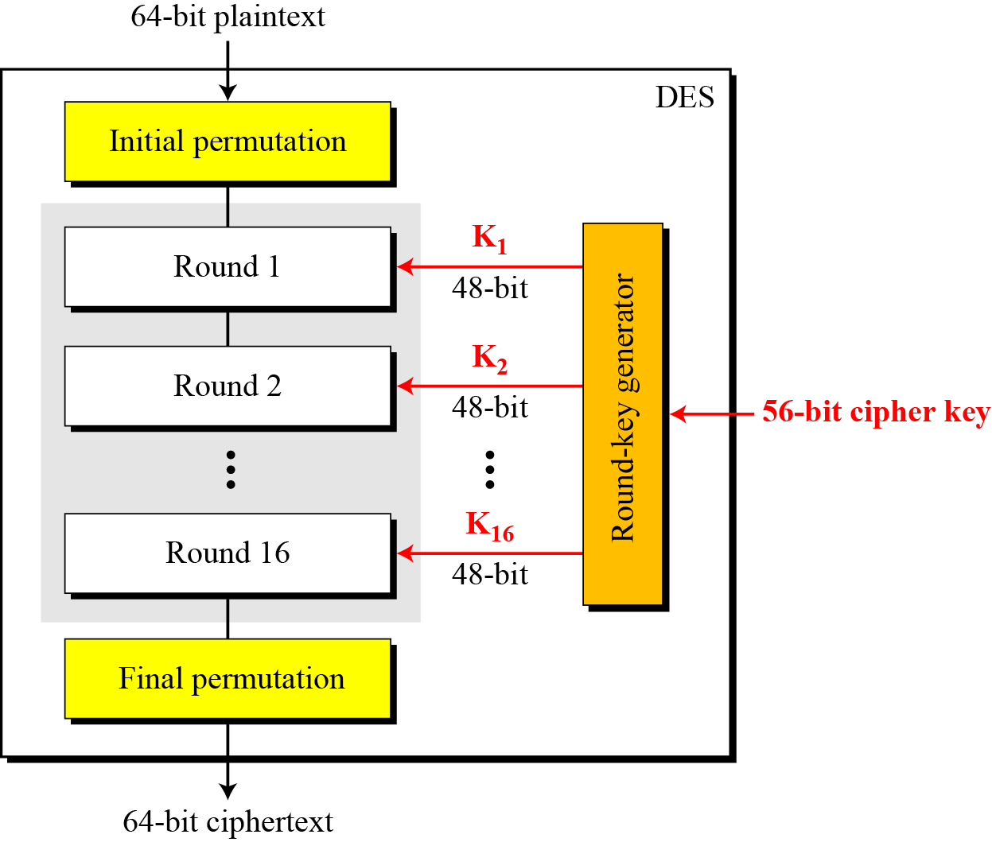
4-2 Continue
Figure 6.2 General structure of DES

Slide 26
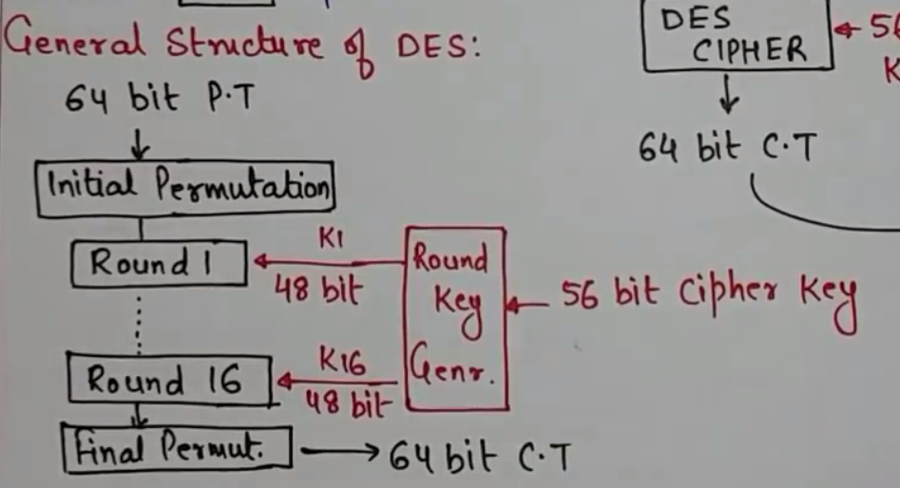

Slide 27
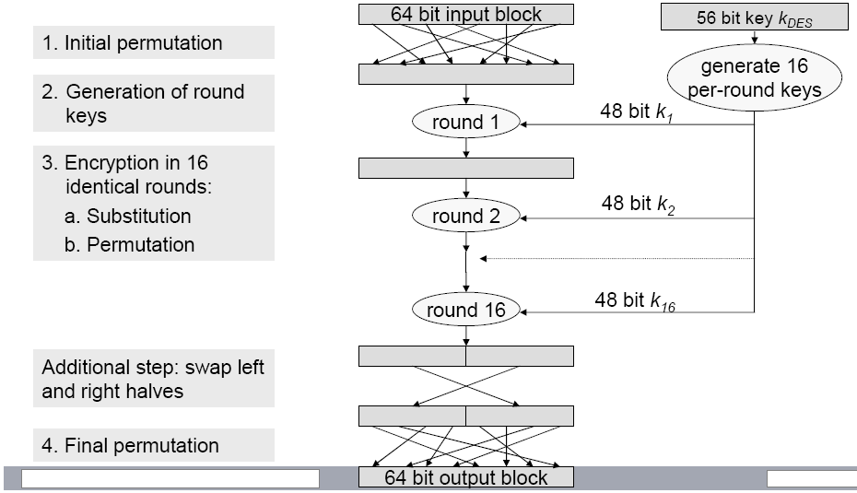
DES Encryption Process

Slide 28
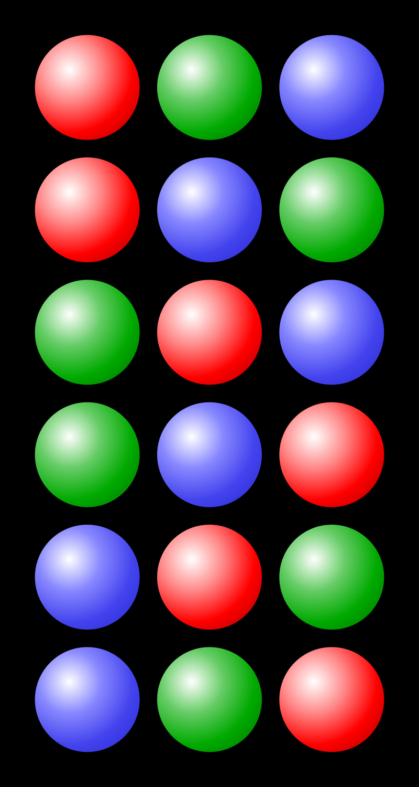
In mathematics, a permutation of a set is, loosely speaking, an arrangement of its members into a sequence or linear order, or if the set is already ordered, a rearrangement of its elements. The word "permutation" also refers to the act or process of changing the linear order of an ordered set.
Each of the six rows is a different permutation of three distinct balls

Slide 29
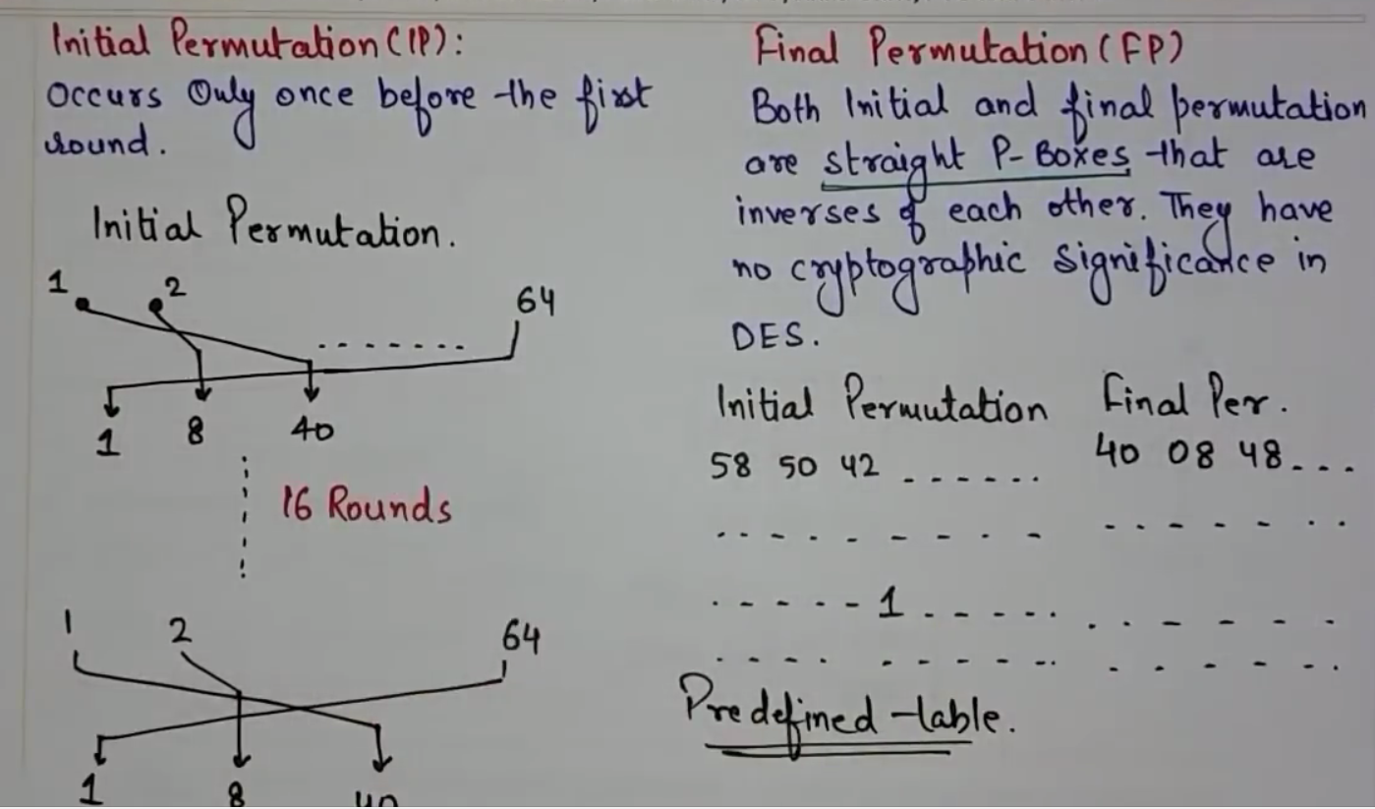

Slide 30
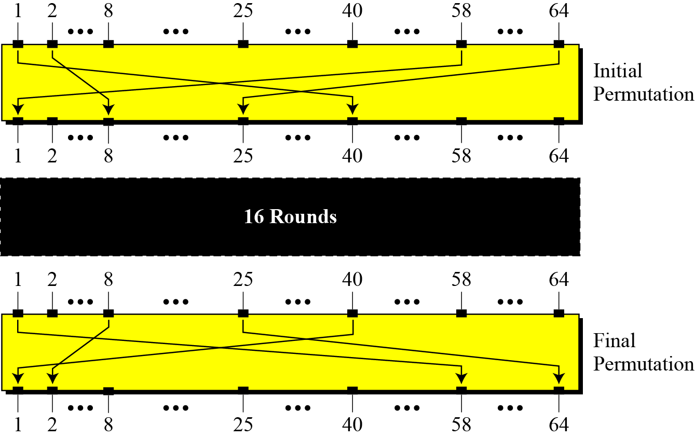
4.2.1 Initial and Final Permutations
Figure 6.3 Initial and final permutation steps in DES

Slide 31
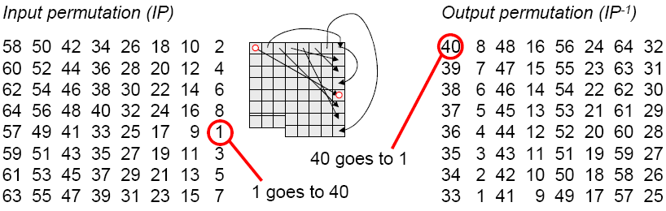
Step 1 & 4: Initial and Final Permutation
Input permutation
See each 64-bit block as 8 Bytes, arranged in a matrix
Diffusion of bits over all bytes
Bits of a column are packed into a row
First byte is spread into 8th bits of all bytes
Second byte is spread into 7th bits of all bytes
...

Slide 32
4.2.1 Continue
Table 6.1 Initial and final permutation tables

Slide 33
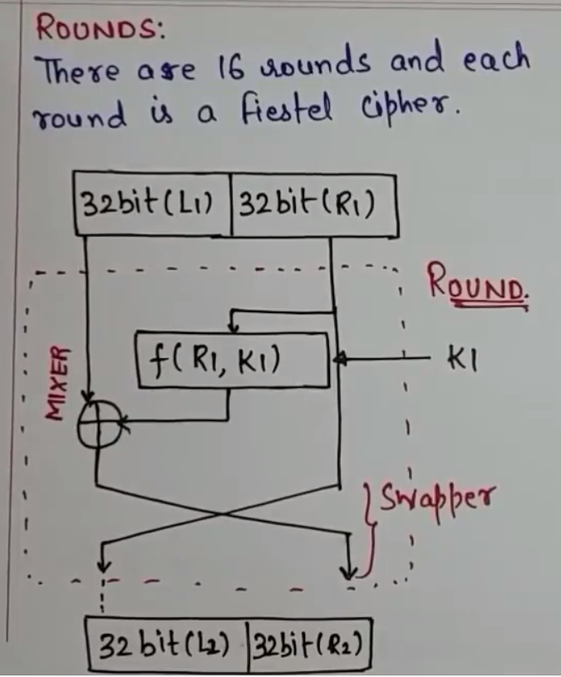

Slide 34
4.2.1 Continued
Note
The initial and final permutations are straight P-boxes that are inverses of each other.
They have no cryptography significance in DES.

Slide 35
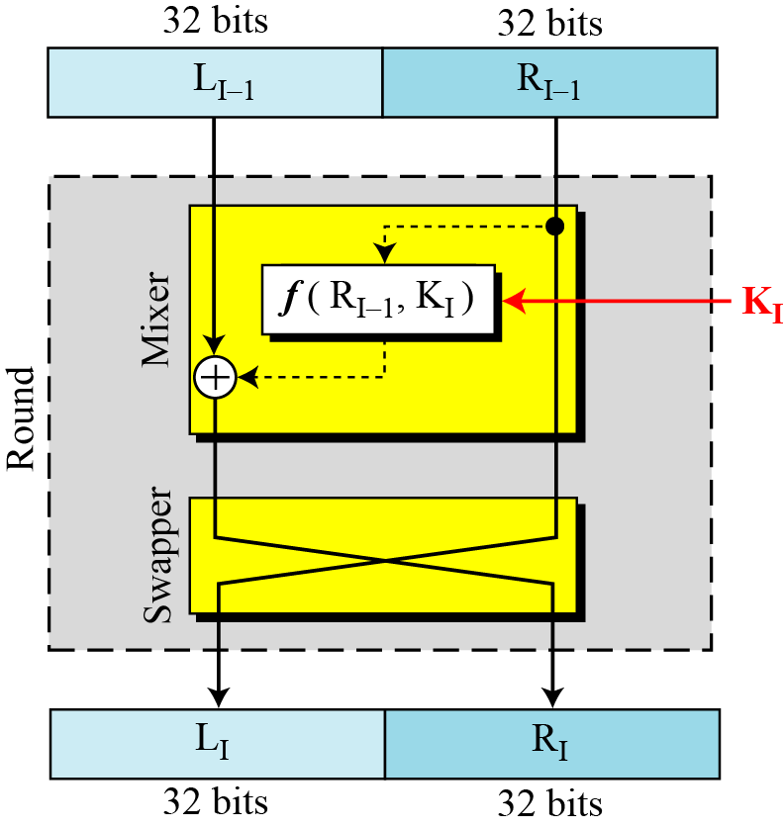
4.2.2 Rounds
DES uses 16 rounds. Each round of DES is a Feistel cipher.
Figure 6.4 A round in DES (encryption site)

Slide 36
DES: core idea – Feistel Network
DES is based on Feistal Network
Consists of invertible function F: {0,1}^{2n} ⟶ {0,1}^{2n}
n-bits
R₀
R₁
R₂
R_{d-1}
R_{d}
f₁
f₂
⋯
f_{d}
L₀
L₁
L₂
L_{d-1}
L_{d}
n-bits
⊕
⊕
⊕
input
output
In symbols:

Slide 37
Inverse of Feistal Function
Feistel network F: {0,1}^{2n} ⟶ {0,1}^{2n} is invertible
R_{i-1}
R_{i}
R_{i-1} = L_{i}
L_{i-1} = f_{i}(L_{i}) ⨁ R_{i}
inverse
f_{i}
L_{i-1}
L_{i}
⊕
R_{i-1}
R_{i}
R_{i}
⊕
R_{i-1}
inverse
f_{i}
L_{i}
f_{i}
L_{i-1}
L_{i-1}
L_{i}
⊕

Slide 38
Decryption circuit
R_{d}
⊕
⊕
⊕
n-bits
R_{d-1}
R_{d-2}
R₁
R₀
⋯
f_{d}
f_{d-1}
f₁
L_{d}
L_{d-1}
L_{d-2}
L₁
L₀
n-bits
Decryption is basically the same Inverted circuit, with f₁, …, f_{d} applied in reverse order

Slide 39
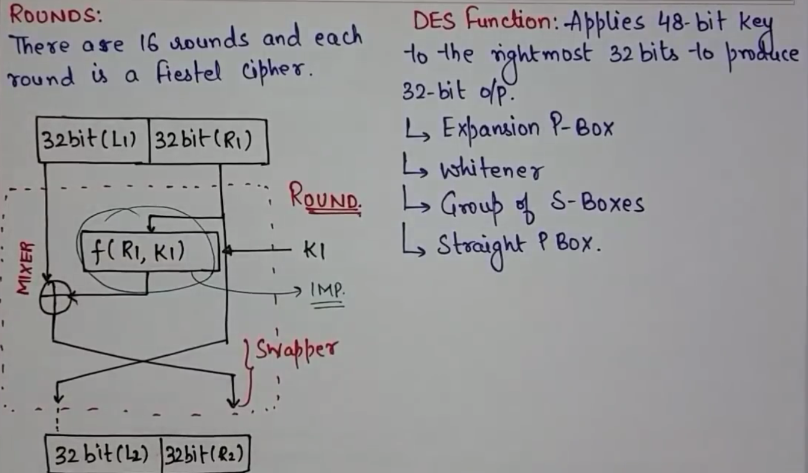

Slide 40
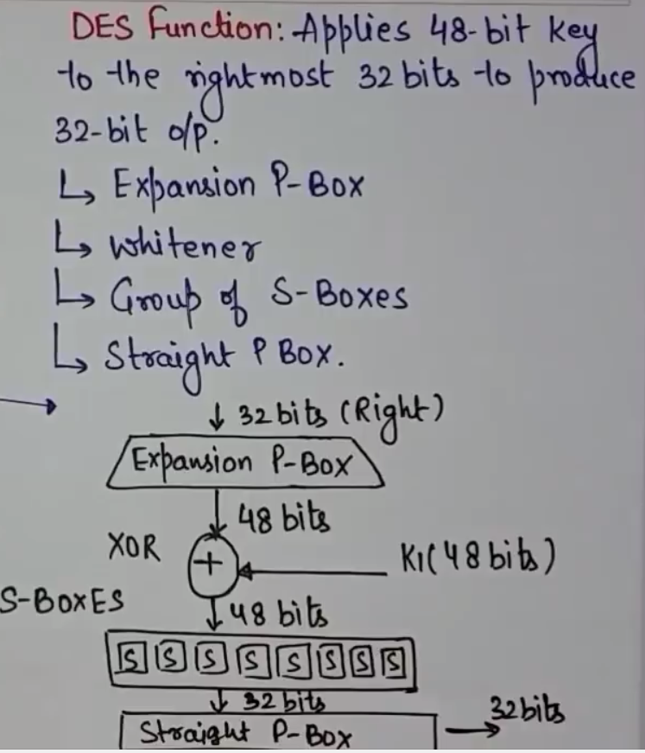

Slide 41
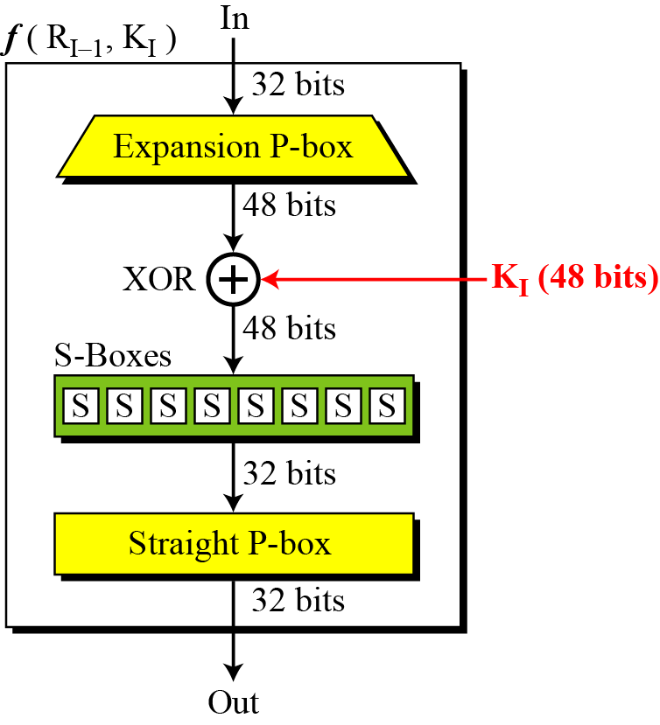
4.2.2 Continued
DES Function
The heart of DES is the DES function. The DES function applies a 48-bit key to the rightmost 32 bits to produce a 32-bit output.
Figure 6.5 DES function

Slide 42
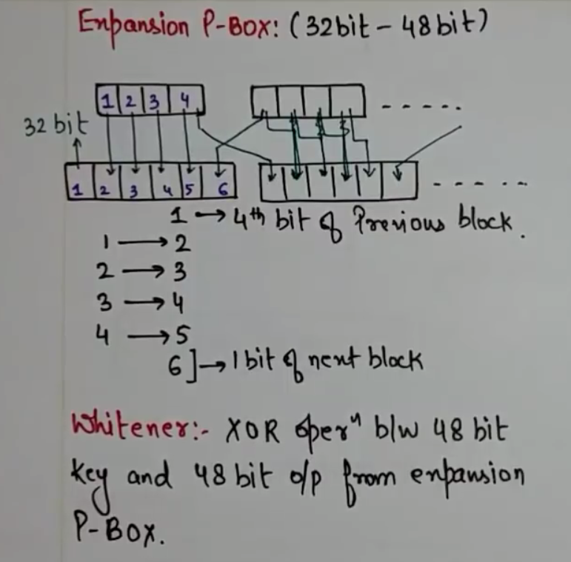

Slide 43
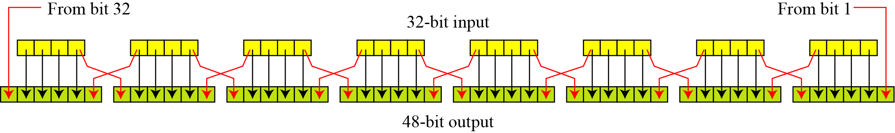
4.2.2 Continue
Expansion P-box
Since R_{I−1} is a 32-bit input and K_{I} is a 48-bit key, we first need to expand R_{I−1} to 48 bits.
Figure 6.6 Expansion permutation

Slide 44
4.2.2 Continue
Although the relationship between the input and output can be defined mathematically, DES uses Table 6.2 to define this P-box.
Table 6.6 Expansion P-box table

Slide 45
4.2.2 Continue
Whitener (XOR)
After the expansion permutation, DES uses the XOR operation on the expanded right section and the round key. Note that both the right section and the key are 48-bits in length. Also note that the round key is used only in this operation.

Slide 46
S-box
From Wikipedia, the free encyclopedia
In cryptography, an S-box (substitution-box) is a basic component of symmetric key algorithms which performs substitution. In block ciphers, they are typically used to obscure the relationship between the key and the ciphertext — Shannon's property of confusion.
In general, an S-box takes some number of input bits, m, and transforms them into some number of output bits, n, where n is not necessarily equal to m.^{[1]} An m×n S-box can be implemented as a lookup table with 2^{m} words of n bits each. Fixed tables are normally used, as in the Data Encryption Standard (DES), but in some ciphers the tables are generated dynamically from the key (e.g. the Blowfish and the Twofish encryption algorithms).

Slide 47
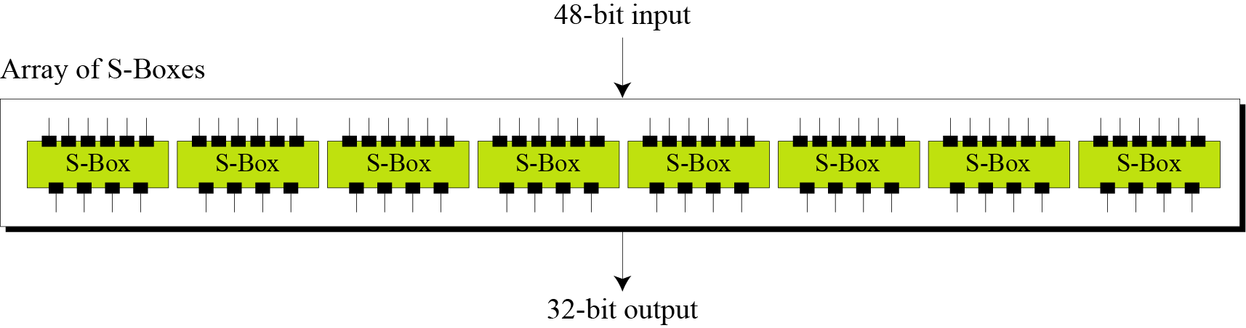
4.2.2 Continue
S-Boxes
The S-boxes do the real mixing (confusion). DES uses 8 S-boxes, each with a 6-bit input and a 4-bit output. See Figure 6.7.
Figure 6.7 S-boxes

Slide 48
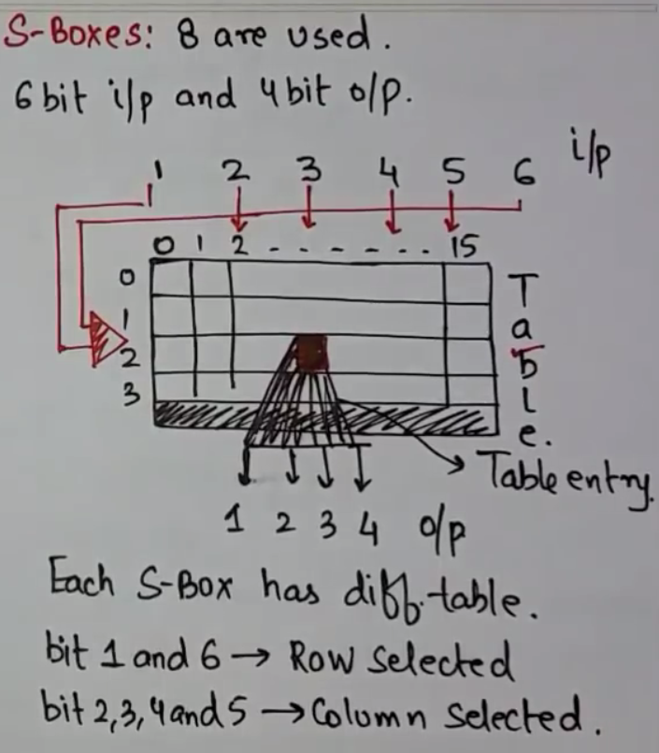

Slide 49
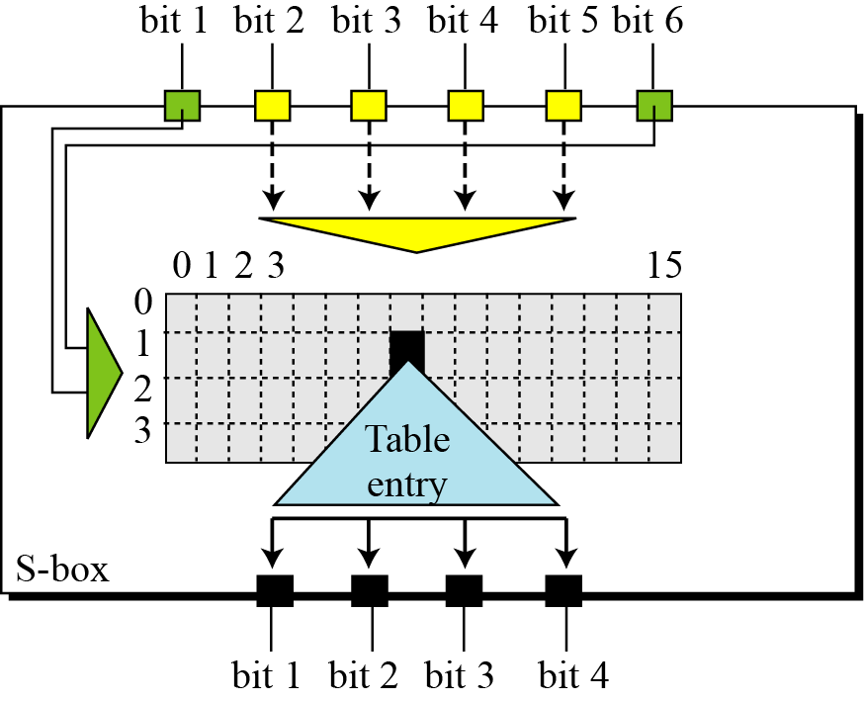
4.2.2 Continue
Figure S-box rule

Slide 50
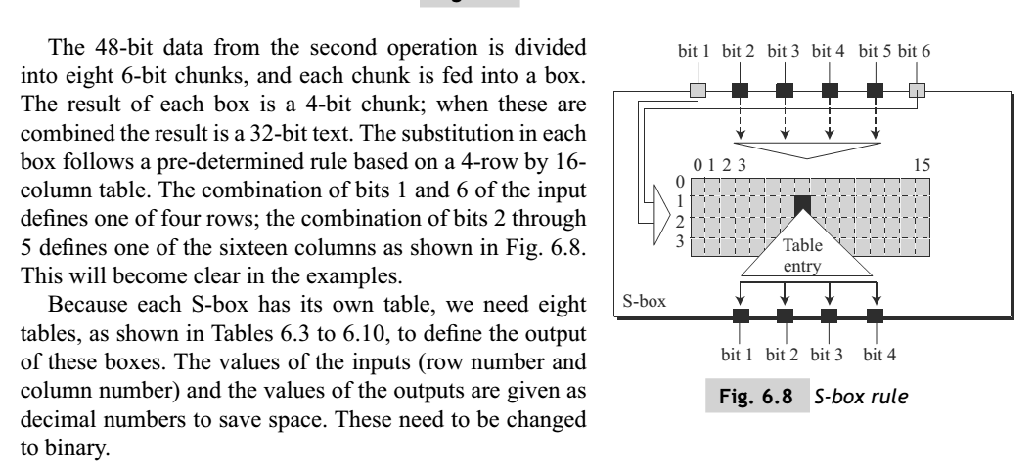

Slide 51
Continue
Table 4.3 shows the permutation for S-box 1. For the rest of the boxes see the textbook.
Table 6.3 S-box 1

Slide 52
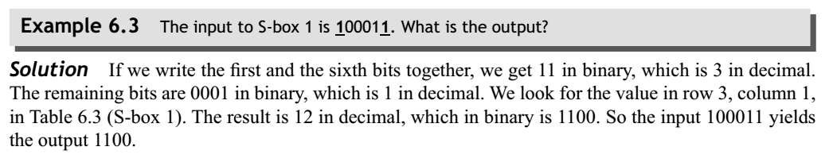

Slide 53
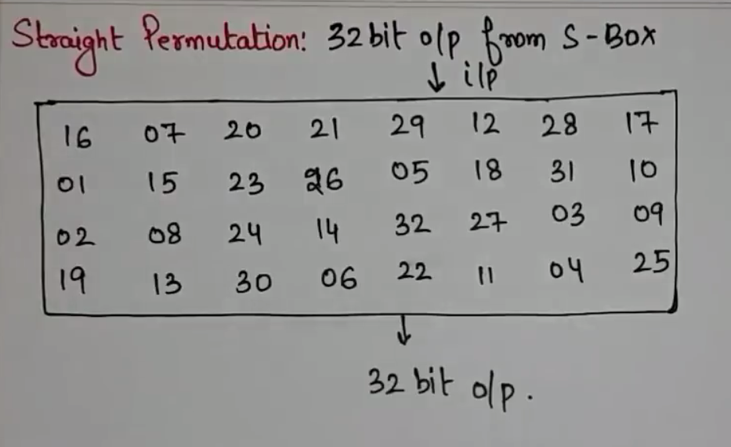

Slide 54
4.2.2 Continue
Straight Permutation
Table 6.11 Straight permutation table

Slide 55
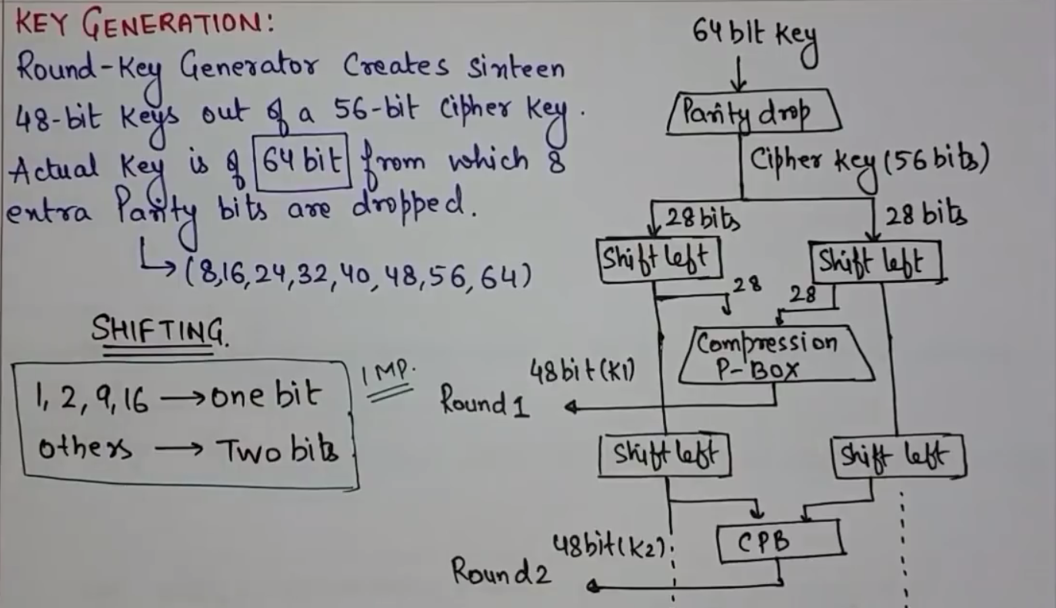

Slide 56
Key Generation
The round-key generator creates sixteen 48-bit keys out of a 56-bit cipher key.
However, the cipher key is normally given as a 64-bit key in which 8 extra bits are the parity bits, which are dropped before the actual key-generation process, as shown in Fig.

Slide 57
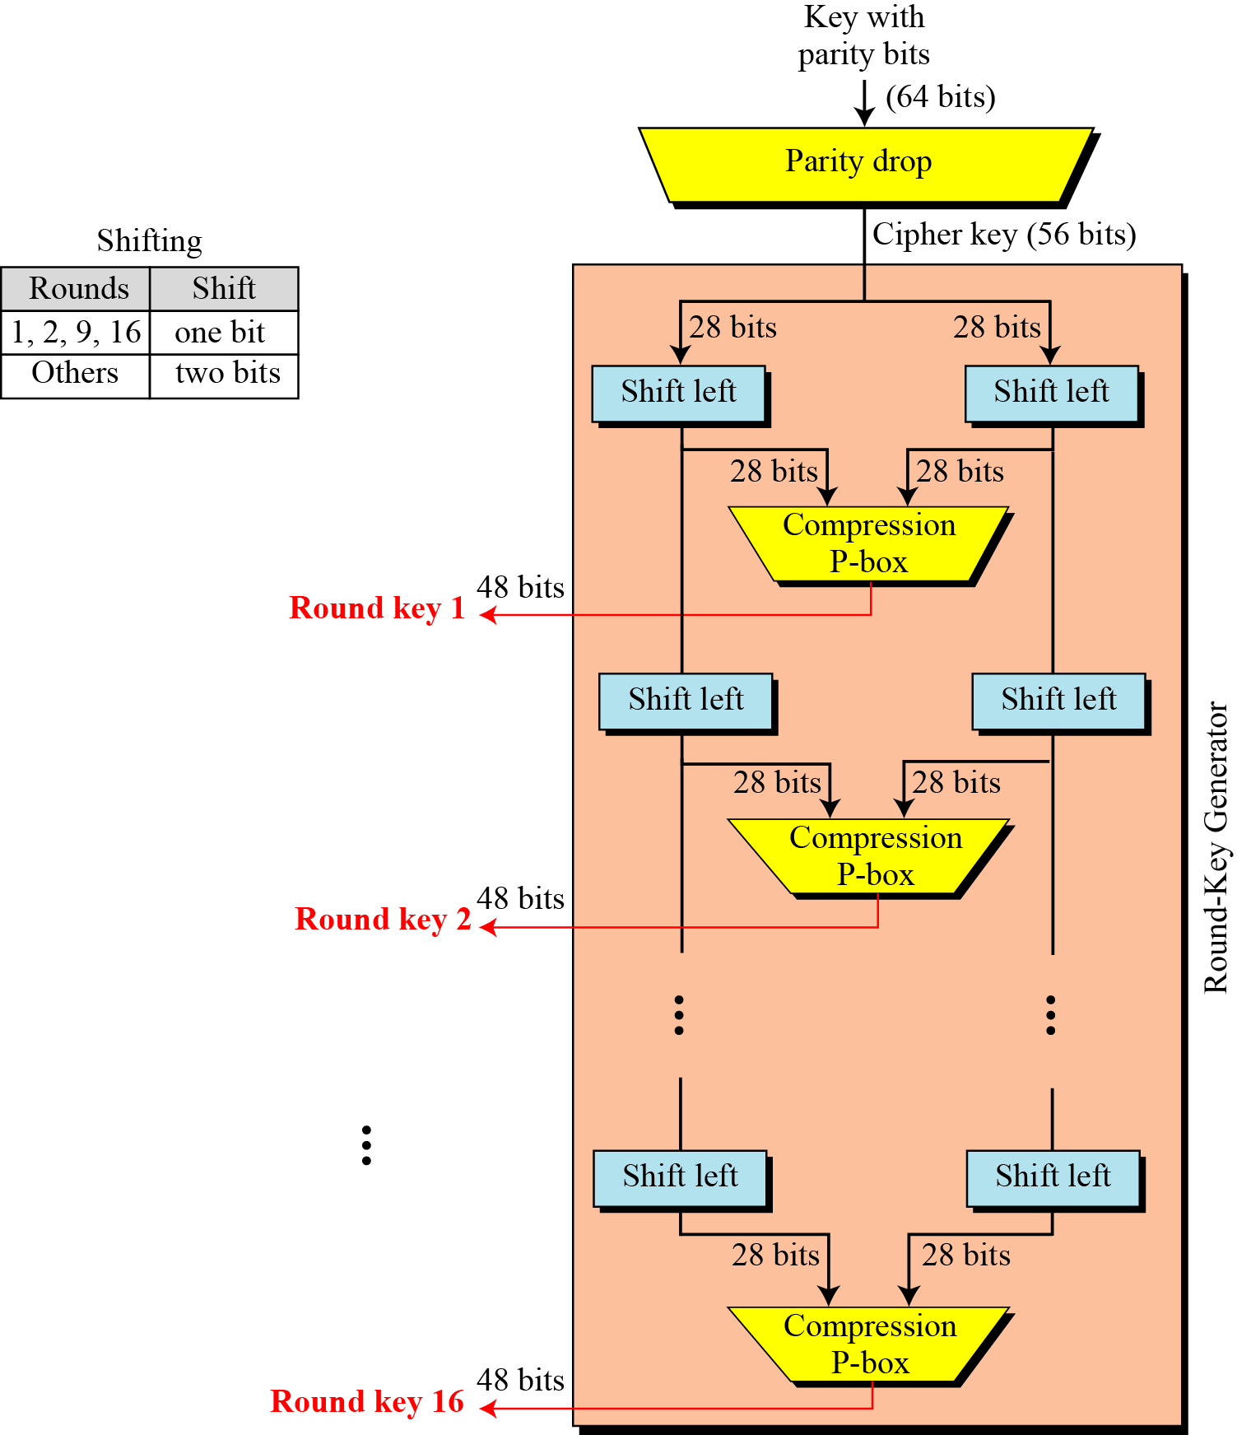
Key Generation Continued
Figure Key generation

Slide 58
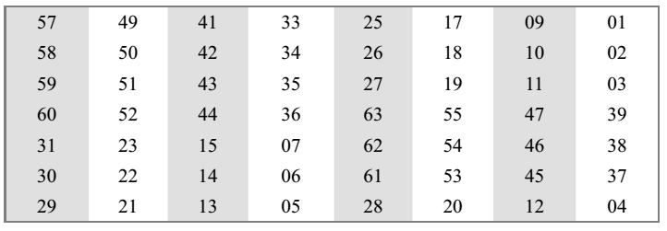
Generation of Round Keys
Parity Drop The preprocess before key expansion is a compression transposition step that we call parity bit drop.
It drops the parity bits (bits 8, 16, 24, 32, …, 64) from the 64-bit key and permutes the rest of the bits according to Table 6.12.
The remaining 56-bit value is the actual cipher key which is used to generate round keys.
The parity drop step (a compression D-box) is shown in Table
Initial Key permutation and parity bit drop table

Slide 59
Shift Left After the straight permutation, the key is divided into two 28-bit parts.
Each part is shifted left (circular shift) one or two bits.
In rounds 1, 2, 9, and 16, shifting is one bit; in the other rounds, it is two bits.
The two parts are then combined to form a 56-bit part. Table 6.13 shows the number of shifts for each round.
Number of bits shift

Slide 60
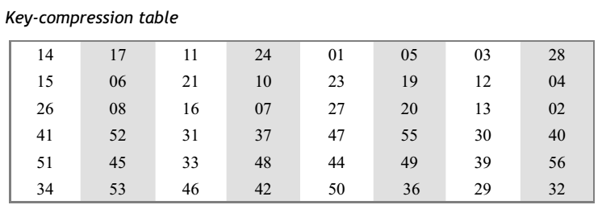
Compression D-box The compression D-box changes the 58 bits to 48 bits, which are used as a key for a round.
The compression step is shown in Table

Slide 61
4.2.3 Continued
Table 6.12 Parity-bit drop table
Table 6.13 Number of bits shifts

Slide 62
Generation of Round Keys
Characteristics of key generation
Left shift
round 1, 2, 9, and 16: left shift of 1 bit
other rounds: left shift of 2 bits
Notice: 10 years later it was found, that performing the left shift with varying step sizes makes the algorithm more secure
Left half of Ki is only determined by Ci, right side only by Di
Permutations (compression P-box):
perform permutations on remaining bits of Ci and Di to obtain Ki (48 bits)
Ci: bits 9, 18, 22, and 25 are discarded (remaining: 24 bits)
Di: bits 35, 38, 43, and 54 are discarded (remaining: 24 bits)
Notice: the choice of the permutations on Ci and Di influence the security of DES, because they determine the quality of the round keys

Slide 63
4.2.3 Cipher and Reverse Cipher
Using mixers and swappers, we can create the cipher and reverse cipher, each having 16 rounds.
First Approach
To achieve this goal, one approach is to make the last round (round 16) different from the others; it has only a mixer and no swapper.
Note
In the first approach, there is no swapper in the last round.

Slide 64
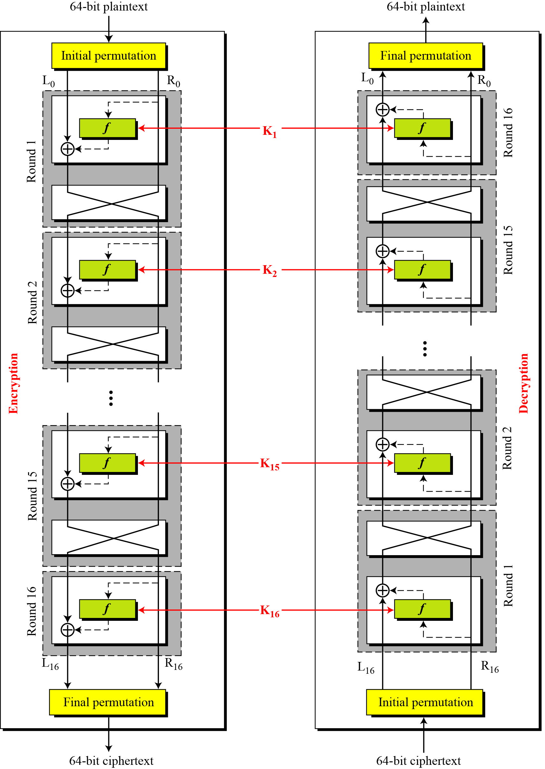
4.2.3 Continued
Figure 6.9 DES cipher and reverse cipher for the first approach

Slide 65
4.2.3 Continued
Alternative Approach
We can make all 16 rounds the same by including one swapper to the 16th round and add an extra swapper after that (two swappers cancel the effect of each other).

Slide 66
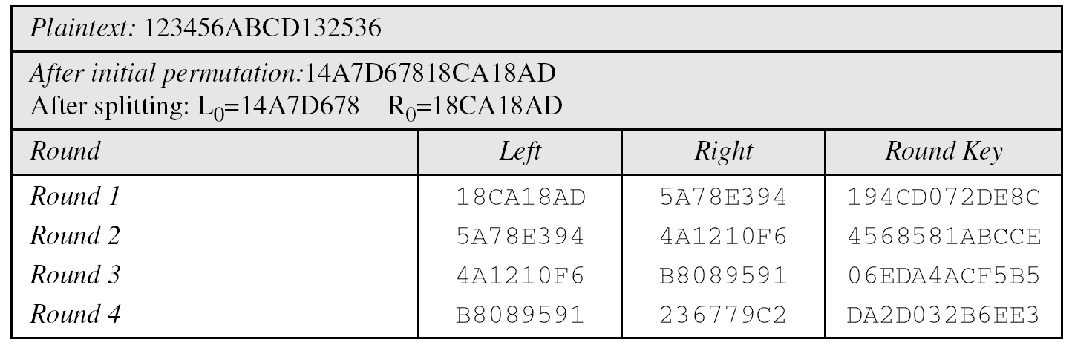
4.2.4 Examples
Example 6.5
We choose a random plaintext block and a random key, and determine what the ciphertext block would be (all in hexadecimal):
Table 6.15 Trace of data for Example 6.5

Slide 67
4.2.4 Continued
Example 6.5
Continued
Table 6.15 Trace of data for Example 6.5 (Conintued

Slide 68
The plaintext goes through the initial permutation to create completely different 64 bits (16 hexadecimal digit).
After this step, the text is split into two halves, which we call L0 and R0.
The table shows the result of 16 rounds that involve mixing and swapping (except for the last round).
The results of the last rounds (L16 and R16) are combined. Finally the text goes through final permutation to create the ciphertext

Slide 69
Some points are worth mentioning here.
First, the right section out of each round is the same as the left section out of the next round.
The reason is that the right section goes through the mixer without change, but the swapper moves it to the left section.
For example, R1 passes through the mixer of the second round without change, but then it becomes L2 because of the swapper.
The interesting point is that we do not have a swapper at the last round. That is why R15 becomes R16 instead of becoming L16.

Slide 70
Step 3: Application of Rounds (16 round Feistel network)
k
key expansion
⋯
k₁
k₂
k₁₆
16 round Feistel network or cipher functions
IP
IP⁻¹
64 bits
64 bits
input
output
To invert, use keys in reverse order

Slide 71
DES Design Criteria
What are the design criteria for the building blocks of the DES algorithm?
This is out of the scope of this course. Interested parties are referred to the following references:
B. Schneier, Applied Cryptography, 2nd Edition, John Wiley & Sons, 1996, pp. 293–294.
D. Coppersmith, The Data Encryption Standard (DES) and Its Strength Against Attacks, IBM Journal of Research and Development, May 1994.

Slide 72
Comments
Security of DES
DES is seen as very secure (except for the key length)
No attacks with lower costs than a Brute Force attack are known as far
There are some so-called weak keys and semi-weak keys
These keys should not be used!
Questions on DES
Design process for DES was not public
Are details well-chosen for strength of the DES algorithm?
Are some weaknesses useful for people involved in the design process?
Are there other weak keys than the known ones?

Slide 73
Choosing the S-boxes and P-box
Choosing the S-boxes and P-box at random would result in an insecure block cipher (key recovery after ≈2²⁴ outputs) [BS’89]
Several rules used in choice of S and P boxes:
No output bit should be close to a linear function of the input bits
Ensure that bits of the output of an S-Box on one round affects the input of multiple S-Boxes in the next round
Two of the output bits of one S-Box should influence the middle of the result, the other two bits should influence the edges
The 4 output bits should form the input of 6 S-Boxes in the next round
⋮

Slide 74
Properties
Two desired properties of a block cipher are the completeness and the avalanche effect.
Completeness effect means that each bit of the ciphertext needs to depend on many bits on the plaintext
Avalanche effect means a small change in either the plaintext or the key should produce a significant change in the ciphertext.
The avalanche effect is in fact a measure of diffusion.
Remark: Linear functions are usually for diffusion.

Slide 75
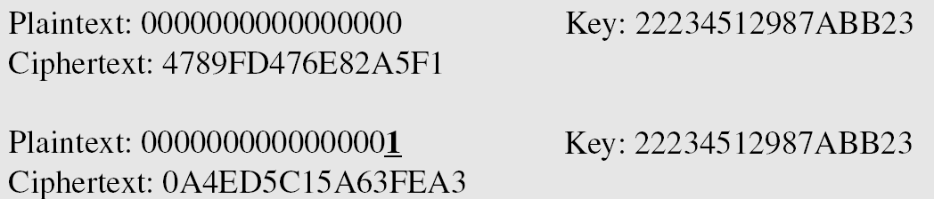
Example of Avalanche Effect
To check the avalanche effect in DES, let us encrypt two plaintext blocks (with the same key) that differ only in one bit and observe the differences in the number of bits in each round.

Slide 76
Example of Avalanche Effect
Although the two plaintext blocks differ only in the rightmost bit, the ciphertext blocks differ in 29 bits. This means that changing approximately 1.5 percent of the plaintext creates a
change of approximately 45 percent in the ciphertext.
Number of bit differences for Example

Slide 77
To Summarize
S-Boxes
The design provides confusion (non-linearity) of bits from each round to the next.
P-Boxes
They provide diffusion of bits.
Number of Rounds
DES uses sixteen rounds of Feistel ciphers. the ciphertext is thoroughly a random function of plaintext and ciphertext.

Slide 78
Security of DES
DES, as the first important block cipher, has gone through much scrutiny. Among the attempted attacks, three are of interest:
Brute-force
Due to the weakness of short cipher key DES can be broken using 2⁵⁵ encryptions.
Differential Cryptanalysis
It has been revealed that the designers of DES already knew about this type of attack and designed S-boxes and chose 16 as the number of rounds to make DES specifically resistant to this type of attack.
Linear Cryptanalysis
Linear cryptanalysis is newer than differential cryptanalysis. DES is more vulnerable to linear cryptanalysis than to differential cryptanalysis. S-boxes are not very resistant to linear cryptanalysis. It has been shown that DES can be broken using 2⁴³ pairs of known plaintexts. However, from the practical point of view, finding so many pairs is very unlikely.

Slide 79
Attacks
Best key recovery attack:
four times better than ex. search [BKR’11]
Related key attack on AES-256: [BK’09]
Given 2⁹⁹ inp/out pairs from four related keys in AES-256 can recover keys in time ≈2⁹⁹
Notes:
Instead of 128bit keys you will be thinking of 126 bits key --- essentially security is not hurt
2^99 is still higher than what we can run today

Slide 80
One-time and Many-time keys
One-time keys
Adversary’s power:
Adv sees only one ciphertext (one-time key)
Adversary’s goal:
Learn info about PT from CT (semantic security)
Many-time keys
Adversary’s power:
Adv have access to plaintext and its corresponding ciphertext
Adversary’s goal:
Learn info about PT and Key from CT/PT pair (semantic security against chosen/known Plaintext attacks)
Notes:
Today: we build ciphers that are semantically secure against one-time use
And ciphers that are semantically secure against many-time use

Slide 81
Acknowledgements
Material in this lecture are taken from the slides prepared by:
Prof. Dan Boneh (Stanford)
Prof. O. Spaniol (RWTH Aachen)

